Slide 1

Modeling baggage selection likelihood using eDreams booking data
Stéphane Couvreur
Data Scientist Interview

Slide 2
Data
Bookings from one day (1st of on all eDreams platforms

Slide 4
Distribution

Slide 7
Feature engineering

Slide 9
Model building and tuning

Slide 10
Xgboost

Slide 11
Model evaluation

Slide 12
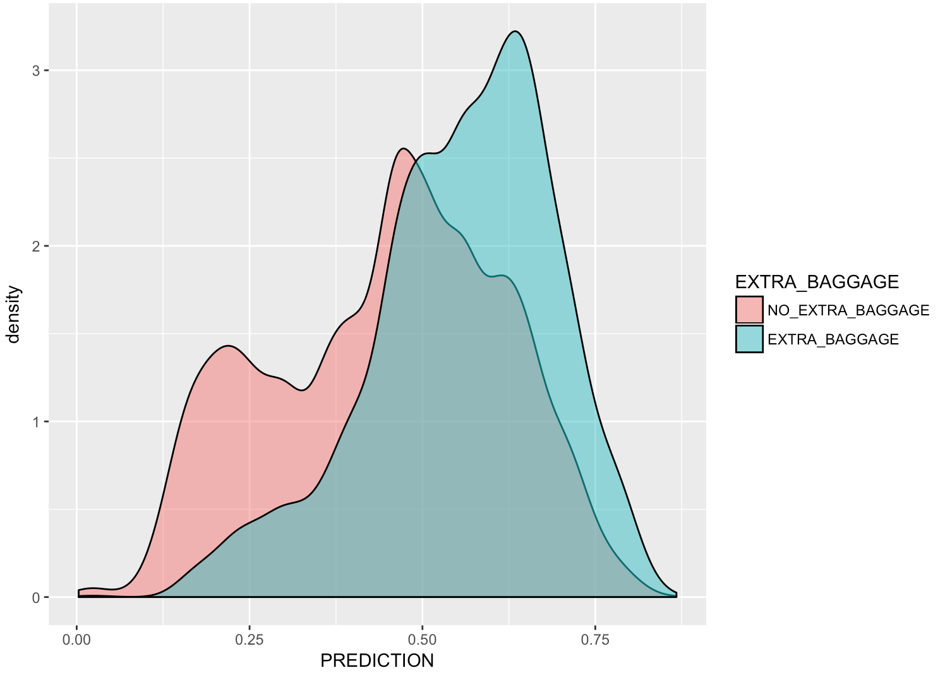
Area under a Receiver Operating Characteristic Curve (AUROC) Logistic Regression model
Insensitive to the chosen threshold

Slide 13
AUROC Graph boosted trees model

